Slide 1
Neural Architectures:
Transformers
Introduction to Deep Learning: Class 5.6

Slide 2
Agenda and Pre-read
Agenda:
Transformer architecture applications
Generating representations: sequence classification, token classification, retrieval
Generating new tokens: summarization, language translation..
Pre-read
BERT
BERT variants
Roberta
mpNet

Slide 3
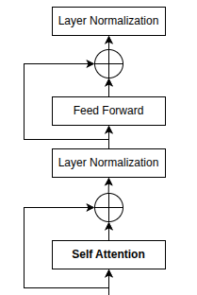
Recall.. Transformer architecture
xN
Token + position embeddings
e1+p1 | e2+p2 | e3+p3 | e4+p4 | e5+p5 | e6+p6 | e7+p7 | e8+p8 | e_pad+p9 | e_pad+p10 | e_pad+p11 | e_pad+p12
Pad mask
1 | 1 | 1 | 1 | 1 | 1 | 1 | 1 | 0 | 0 | 0 | 0
Tokenization + padding
t1 | t2 | t3 | t4 | t5 | t6 | t7 | t8 | pad | pad | pad | pad

Slide 4
What can we do with Transformers
How do we use the transformer architecture to solve various problems?
We’ll focus on text based problems.
Classification: tweet sentiment analysis, intent detection
Per-token labeling: NER
Seq-to-seq: eg., language translation
Generation: sentence completion, question answering
Representation: embedding generation

Slide 5
What changes as we go from one task to the other?
Input representation: tokens for text, patches for images..
Attention masking: bidirectional, causal, local attention..
Training objective: masked-token prediction, next-token prediction, contrastive loss, reconstruction, class prediction
Output head: classifier head, token classifier, language modeling head, embedding projection..

Slide 6
Three main transformer families
Encoder only
Decoder only
Encoder-Decoder

Slide 7
Encoders:
Used for representation learning and understanding. Typical uses:
sequence classification
token classification
sentence embeddings
retrieval encoders
masked language modeling

Slide 8
BERT: Bidirectional Encoder Representations from Transformers
Two steps:
1- Pre-training: Self-supervised training using Masked Language Modeling
2- Task specific training

Slide 9
BERT: Pre-training
Key idea: Hide some words (replace by a special MASK token), and ask the model to predict those words. In doing so, the model learns the syntax of the language, making specialized tasks such as sentiment classification easier.
No ground truth necessary, as the identity of the MASK token is known in advance
The loss is x-entropy loss over the vocabulary. Model outputs vocab logits for each token. For each masked token, we calculate x-entropy loss against the known value of the masked token

Slide 10
BERT: Pre-training
What architectural modifications are needed?
Output
B, T, D
Output is in the embedding space. We need to map it to the vocab space. A trainable FC layer of size (D, V) is added. The output of the FC layer is used to calculate x-entropy loss
The BERT paper also uses Next Sentence Prediction (NSP) loss, but most successors of BERT don’t use it.
Transformer Block
xN
Input
B, T, D

Slide 11
BERT: Classification
X-entropy loss
True Class
For classification, we need to map BERT output to a vector of class probabilities. We could take the average of the output token embeddings.
What is instead done is to prepend a special token [CLS] (short for classification) to the input. The output embedding for this sentence is then projected into the class probability space by multiplying with a learnable classification head matrix
During post-training, we can freeze the weights of the transformer backbone and only train the classification head, or train the entire network
Classification Head (D, C)
C: Number of classes
CLS_e
(1, D)
+
Embeddings for input tokens
Transformer Block
xN
CLS + input tokens + SEP

Slide 12
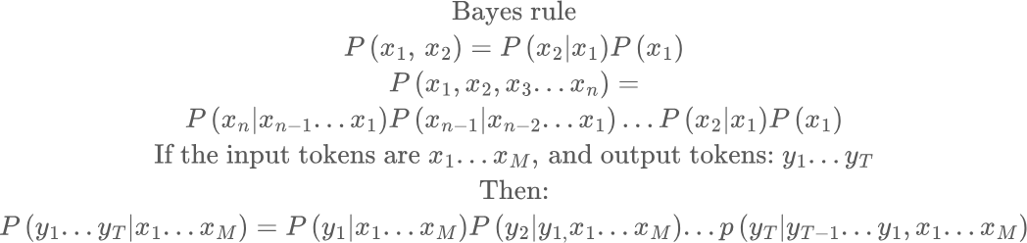
Decoder-only (Generative) models
Key idea: Given some text, predict what follows
Input: the, quick, brown, fox
One plausible output: jumps, over, the..
Predicted tokens
Input tokens
Predict first output token
Add the predicted token to the input context and predict the second token

Slide 13
Decoder-only (Generative) models
Key idea: The model needs to learn to assign higher probabilities to more plausible input sequences
P(model, needs, to, learn) > P(needs, learns, model, to)
Like BERT, the training signal is inherent in the token sequence. How do we utilize this in a generative context?
To do this, each token must only see the tokens before it.. This is implemented using a causal attention mask

Slide 14
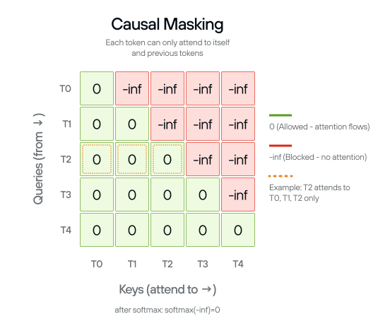
Causal Attention Mask
T0 only sees the keys corresponding to T0
T1 only sees the keys corresponding to T0, T1
T2 only sees the keys corresponding to T0, T1, T2

Slide 15
Generative Model Architecture
X-entropy loss
Target tokens
Hello, how, are, you, <EOS>
Predicting end of a sentence is very important!
<BOS>, Hello, how, are, you
Target logits
Input
Target
Transformer Block
Causal Attention Mask
<BOS>, Hello, how, are, you
Hello, how, are, you, <EOS>
<BOS>, Hello, how, are, you, <EOS>
Input tokens
Tokenization, embedding lookup, positional embeddings remain unchanged
Hello, how, are, you

Slide 16
Decoder-only models
 | Encoder-only | Decoder-only
Attention mask | Full--each token can see all tokens | Causal--each token can only see tokens before it
Loss | Masked language modeling loss | Next token prediction loss
Token and position embeddings | Same | Same
Transformer block | Same (except attention block) | Same (except attention block)

